Slide 1
Portfolio Management System

Slide 2
Presented To:
M Hari Kumar (249514)
Gayathri Mahadevan (t-Gayathri10)
Kanchan Bhise (2122049)
By POD3:
Vishal Gupta (2135887)
Chinta Sundara Sreya (2136868)
Priyanka G (2135338)
Paricheri Neeraja (2135690)
Likhit Manda (2134177)

Slide 3
PROJECT OVERWIEW
A leading Financial Services Organization wants to strengthen its Middleware by exposing the core logic related to Portfolio Management as Microservices.
There will also be a customer Portal to be developed part of this scope that consumes these Microservices to view their portfolio information and sell their assets.

Slide 4
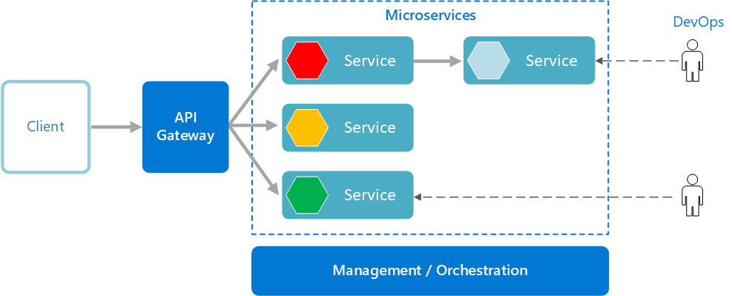
SYSTEM ARCHITECHTURE DIAGRAM

Slide 5
COMPONENTS OF PROJECT
Microservices:
Calculate Net Worth Microservice
Daily Share Price Microservice
Daily Mutual Fund NAV Microservice
Authorization Microservice
Application Portal:
Customer Portal

Slide 6
Calculate Net Worth Microservice
Calculate Net worth Microservice will retrieve the stocks and mutual funds corresponds to the customer portfolio. For each stock it will interact with the Daily share price Microservice to get current market price for that stock and calculate the stock value by multiplying no of shares and current market price of the share. It will sum all the stock value.
The Calculate Networth microservice, for each mutual fund it will interact with Daily Mutual fund NAV Module, to get NAV value of of each mutual fund. It then calculates mutual fund value by multiplying number of units and NAV.

Slide 7
Entities
Portfolio Details
PortfolioId - it is a unique id representing the portfolio
StockList - These are the stocks hold by the customer. Each stock has details which is described below
MutualFundList - These are the Mutual Funds hold by the customer. Each Mutual Fund has details described below
Stock Details
StockName - Name of the stock
StockCount - The number of shares of that stock held by the customer
Mutual Fund Details
MutualFundName - Name of the Mutual Fund
MutualFundUnits - The number of Mutual Fund units hold by the customer
AssetSaleResponse
SaleStatus – True/False
Networth – balance

Slide 8
REST End Points
Calculate Net worth Microservice
GET: /calculateNetworth (Input: PortfolioDetails | Output: Networth – the computed total amount worth in INR)
POST: /sellAssets (Input: currentDetail : PortfolioDetails, saleDetail : PortfolioDetails | AssetSaleReponse – Sale response status and the balance amount)

Slide 9
Daily Share Price Microservice
Daily Share Price allows to fetch the Current Market Price of a Stock
When invoked by Calculate Net Worth Microservice, It retrieves Current Market Price from database and return it to Calculate Net Worth Microservice
Entities:
Stock Details
Stock Id - unique id representing the stock
Stock Name - Name of the stock
Stock Value - Market price in INR
Methods:
GET:/dailySharePrice
Input : Stock Name
Output: Stock Id, Stock Name, Stock Value

Slide 10
Daily Mutual Fund NAV Microservice
Entities
Mutual Fund Details
Mutual Fund Id - It is a unique id representing the Mutual Fund
Mutual Fund Name - Name of the Mutual Fund
Mutual Fund Value - NAV of Mutual Fund
REST End Points
Daily Mutual Fund NAV Microservice
GET: /mutualFundNav (Input: Mutual Fund Name| Output MutualFundDetail)

Slide 11
Authorization Microservice
It Creates JWT (JSON Web Token) for an authentication user who is in Database and then it validates the user based on the JWT token passes in the “Authentication” Request-Header
Methods:
POST:/authenticate
POST:/validate

Slide 12
Customer Portal
Customer Portal must allow a customer to Login. Once successfully logged in, the customer do the following operation:
View Stock Data
View Mutual Fund Data
Calculate Net Worth.
Sell existing assets – Stocks or Mutual funds.

Slide 13

PROJECT SCREENSHOTS

Slide 14
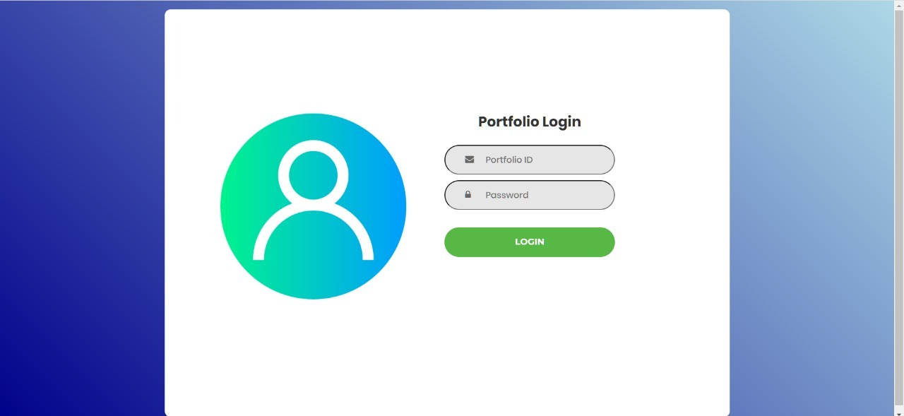

Slide 15
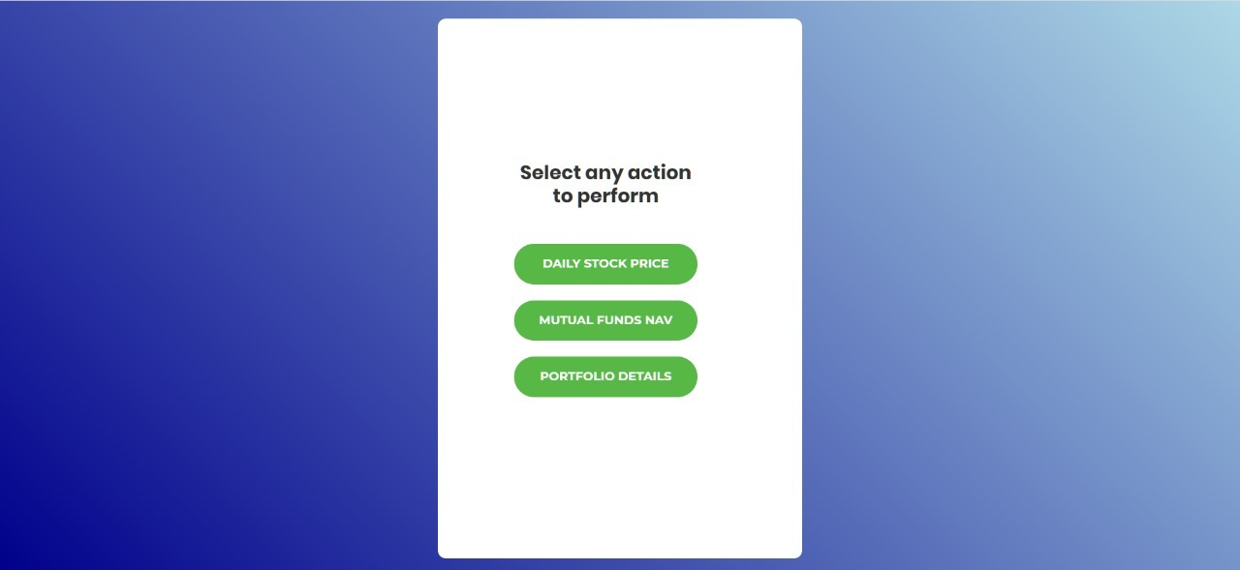

Slide 16
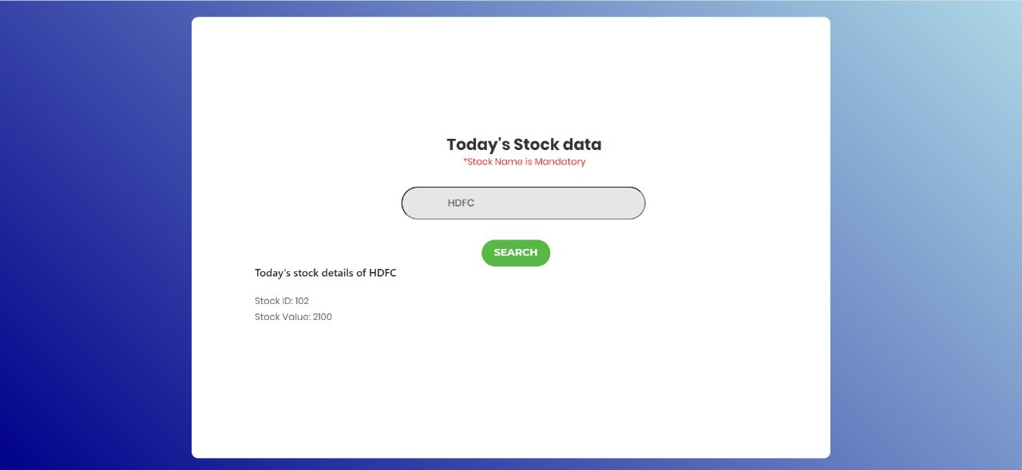

Slide 17
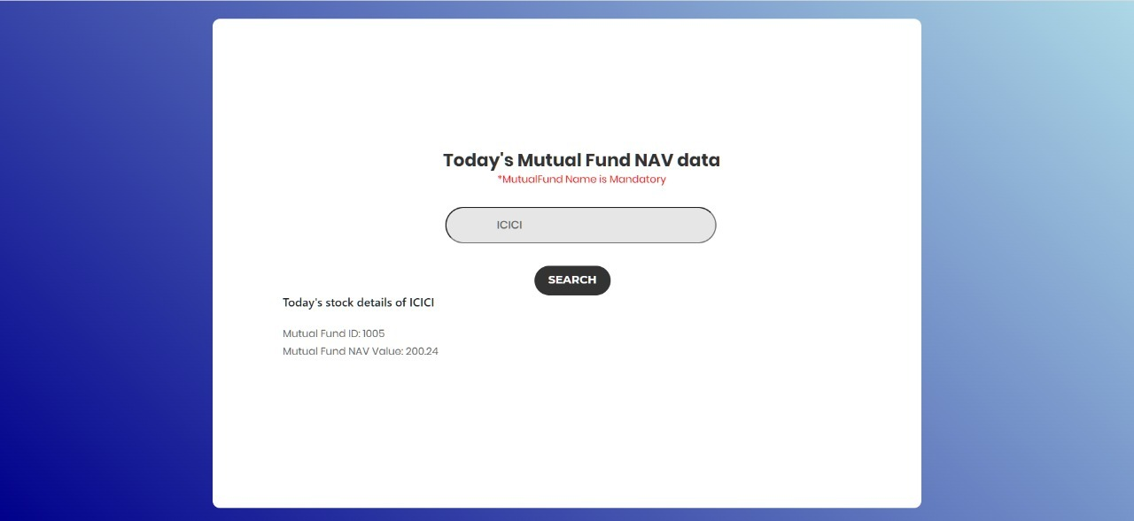

Slide 18
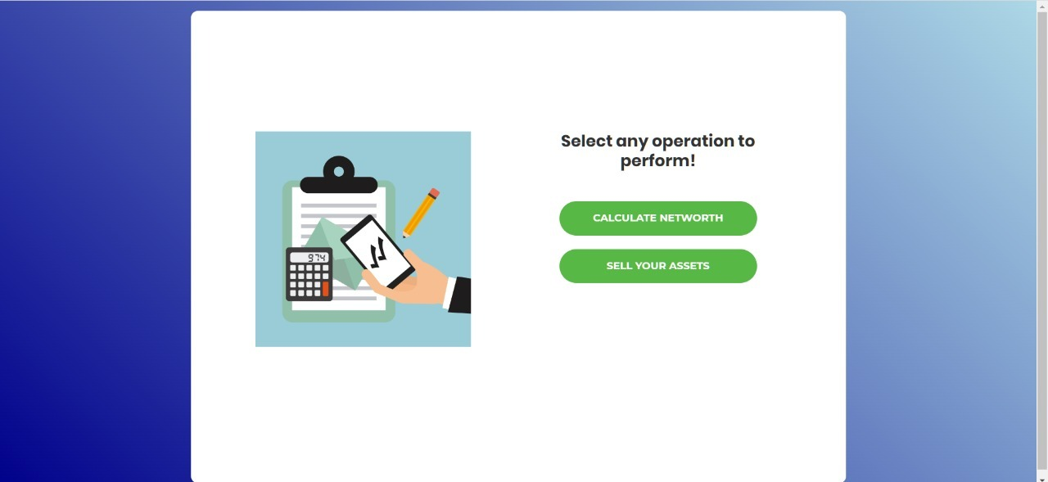

Slide 19
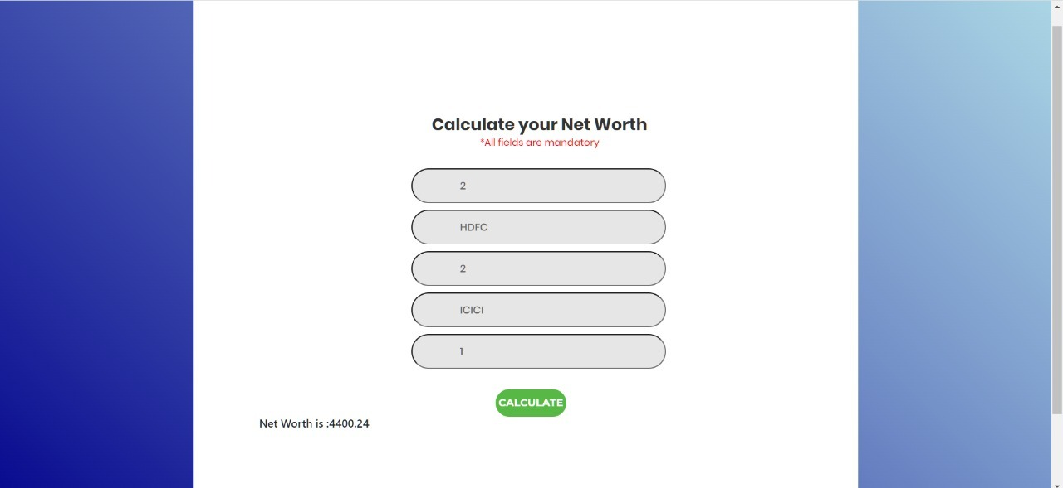

Slide 20
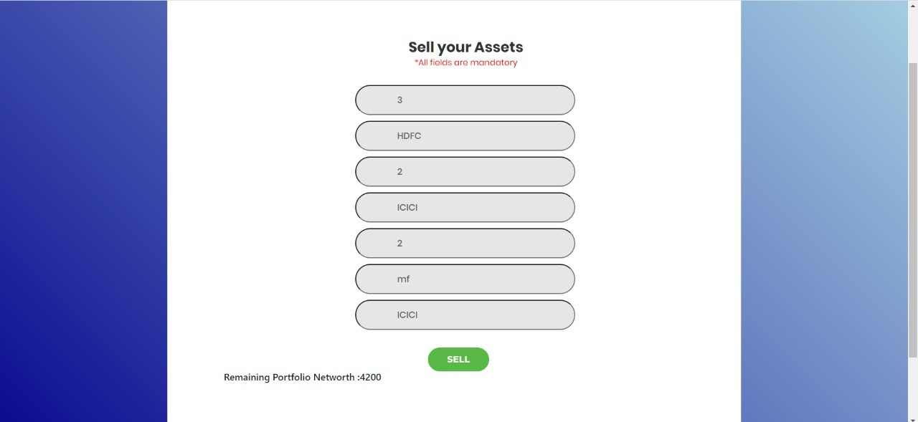

Slide 21
THANK YOU

